Slide 1
THE HARVESTIFY Agricultural production optimization engine
Ritika Baghel
Soumya Agarwal
B.tech(data science)

Slide 2
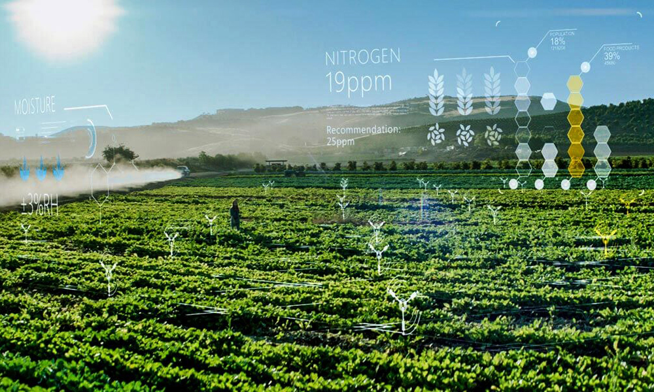
Agricultural production optimization engine
As we all know that agriculture depends largely on the nature of soil and the climatic conditions and many a times, we face unpredictable changes in climate like, non-seasonal rainfall or heat waves or fluctuations in humidity levels, etc. and all such events cause a great loss to our farmers and farming, because of which they are not able to utilize their agricultural land to it's fullest. So to solve all such problems, we have build a model.
This Photo by Unknown Author is licensed under CC BY-SA

Slide 3
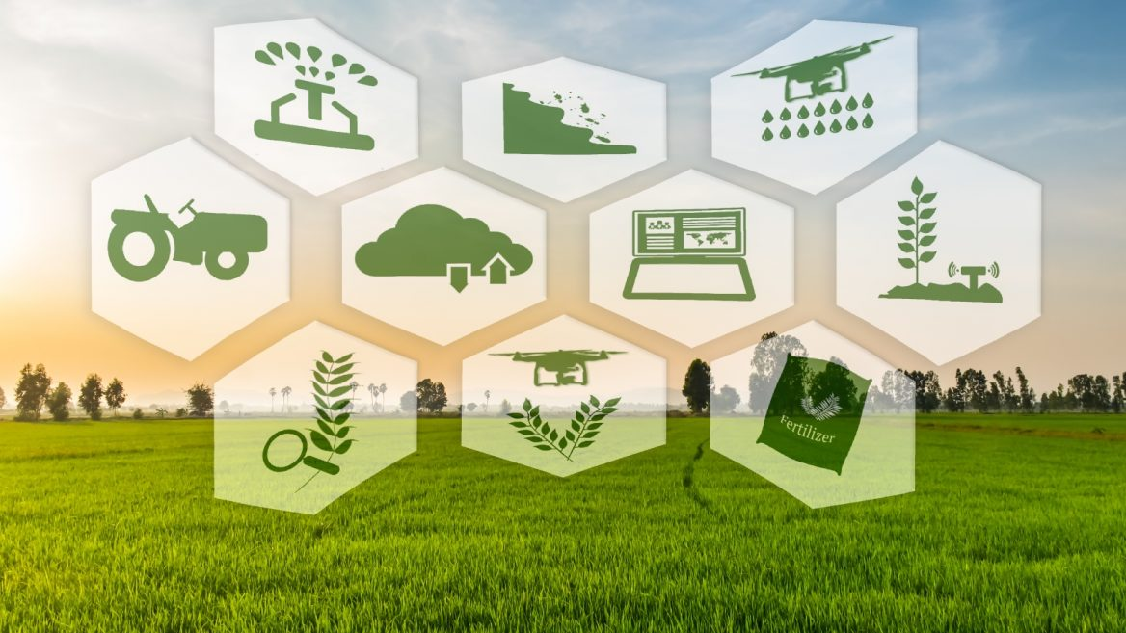
INTRODUCTION
problem statement: Build a predictive model so as to suggest the most suitable crops to grow based on the available climatic and soil condition.
Goal : Achieve precision farming by optimizing the agricultural production.

Slide 4
TOOLS AND TECHNOLOGY
Python libraries (such as numpy, pandas, etc)
Jupiter notebook

Slide 5
Agriculture production optimization engine
There are 7 key factors that I've taken into account which will help us in determining, exactly which crop should be grown and at what period of time, viz. Amount of Nitrogen, Phosphorus and Potassium in soil, Temperature in degree celsius, Humidity, pH and Rainfall in mm.
N N N temperature humidity ph rainfall label
90 42 43 20.87974371 82.00274423 6.502985292 202.9355362 rice
85 58 41 21.77046169 80.31964408 7.038096361 226.6555374 rice
60 55 44 23.00445915 82.3207629 7.840207144 263.9642476 rice
74 35 40 26.49109635 80.15836264 6.980400905 242.8640342 rice
78 42 42 20.13017482 81.60487287 7.628472891 262.7173405 rice
69 37 42 23.05804872 83.37011772 7.073453503 251.0549998 rice
69 55 38 22.70883798 82.63941394 5.70080568 271.3248604 rice

Slide 6
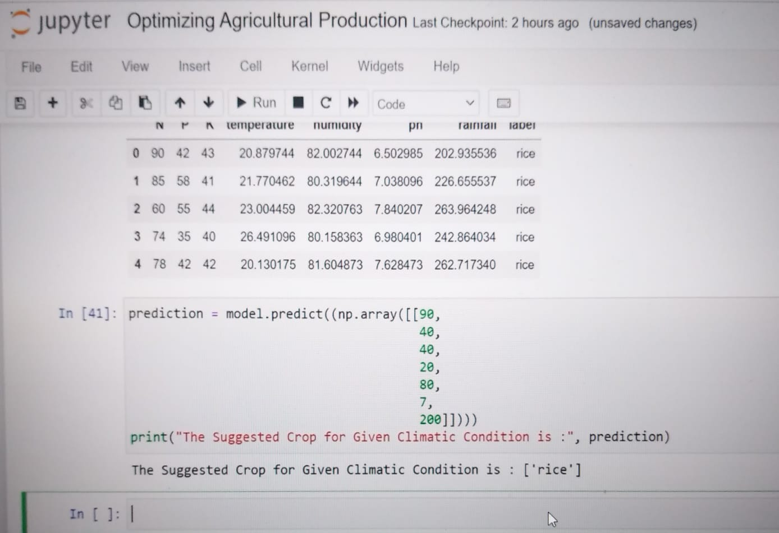
RESULT:
MODEL PREDICTION:
If we input the soil requirements and climatic conditions to this model we get the name of the crop in the output which is best for that particular soil or climatic conditions.

Slide 7
References.
https://towardsdatascience.com/predicting-crops-yield-machine-learning-nanodegree-capstone-project-e6ec9349f69
https://drive.google.com/file/d/1bwv36vs6WKgrJeelGPXhNwI_z120-tOi/view

Slide 8

THANKYOU

